Slide 1
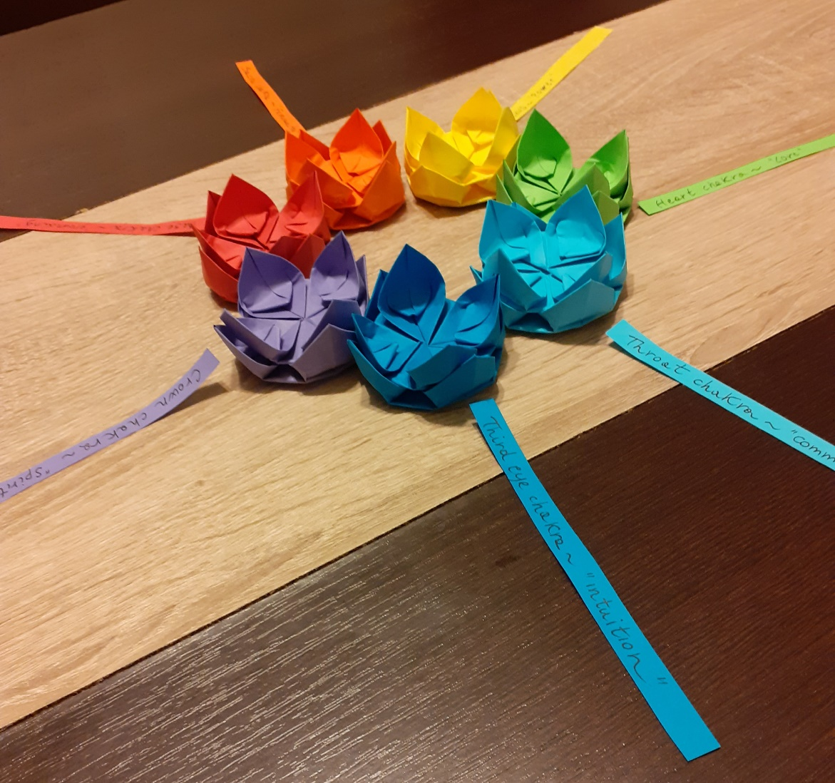
Chakra origami
Monika Cilmi

Slide 2
Agenda
Brief intro about chakras and origami
Materials and tools
Summary of the 8 sessions

Slide 3
Introduction about Chakras
The word chakra comes from Sanskrit meaning “wheel”. They are our body energy centres. Each chakra relates to a specific colour and frequency.
THE ROOT CHAKRA - RED
It governs the earthly instincts. It represents life-force energy and feeling grounded.
THE SACRAL CHAKRA - ORANGE
This chakra is the centre of the emotions, and It represents joy and sensuality.
THE SOLAR PLEXUS CHAKRA - YELLOW
it is related to the nervous system. It links to personal power and mental faculties.
THE HEART CHAKRA - GREEN
It related to the ability to love unconditionally, being compassionate and have balance in life.
THE THROAT CHAKRA - BLUE
This centre governs the communication abilities, having personal opinions and beliefs.
THE THIRD EYE CHAKRA - INDIGO
It relates to the ability to know yourself, trust others and follow your intuition.
THE CROWN CHAKRA - VIOLET
It relates to the feeling of fulfilment. The desire to connect with the universe and spirituality.

Slide 4
Introduction to Origami
Origami is ancient art form from Japan. The word itself means “folding paper”. It has many uses and I see it as a representation of transformation in life through the magic act of folding a simple piece of paper to create 3D exquisite shapes. I teach origami to express creativity, see things with a different perspective, learning that anything is possible. The making of origami and the coloured paper used help to release stress and to be more aware and mindful.

Slide 5
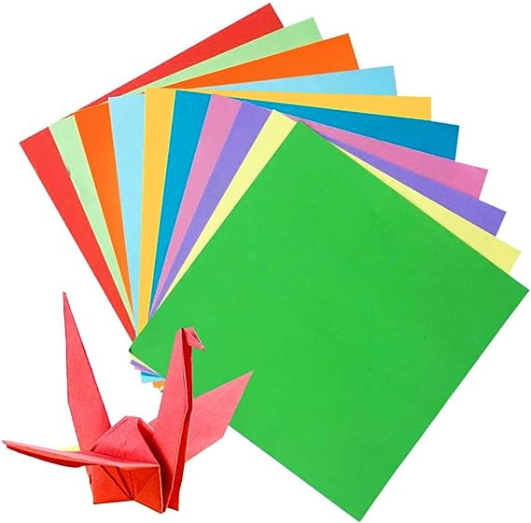
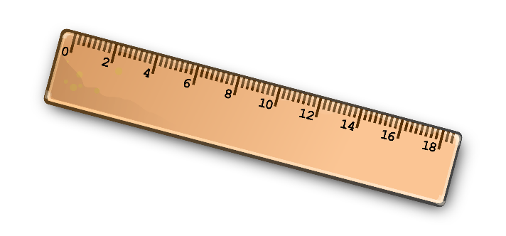
materials
Paper
Scissors
Notebook
ruler

Slide 6
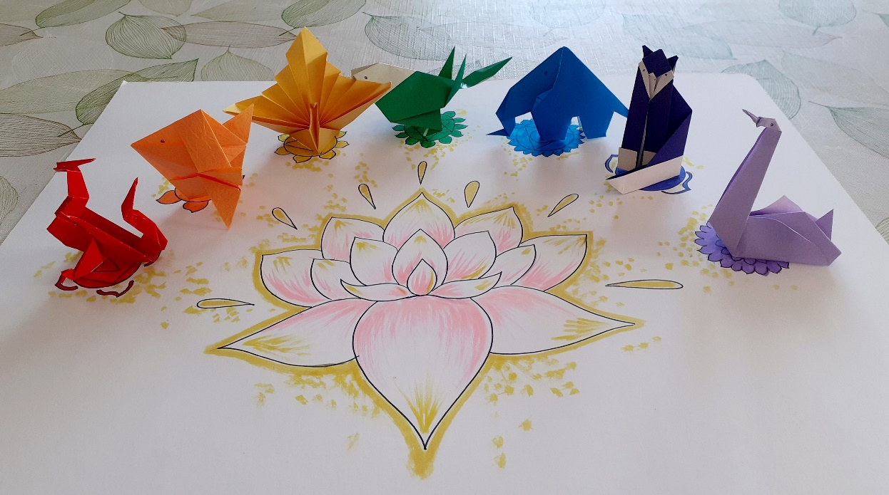
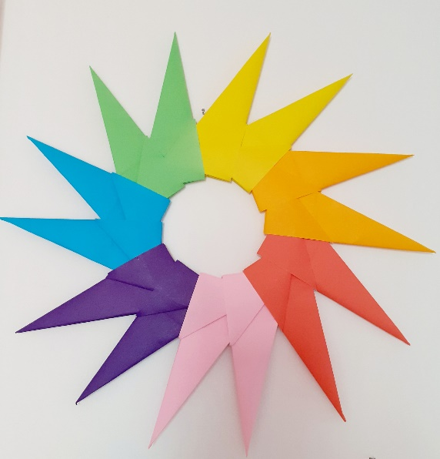
Session's content
Red turtle/dragon
Orange fish
Yellow peacock
Green heart/bird
Blue elephant
Indigo cat
Violet swan
Rainbow star

Slide 7
Thank you!
https://colouryourdream.co.uk

